Slide 1
Hate speech Recognizer
Team 8
Kalyan Varma Patchamatla :- 20011429
Yashita Vajpayee :- 20011237
Sharven Rane :- 20011112
Prof. Shucheng Yu
CPE 695 WS-2

Slide 2
Agenda
Introduction & Objective
Dataset and Preprocessing
Exploratory Data Analysis
Machine Learning Algorithms
4.1 Logistic Regression
4.2 Naïve Bayes
4.3 Random Forest
4.4 Support Vector Machine
4.5 Artificial Neural Network
Future Directions
Conclusion

Slide 3
Introduction
In recent years, the advent of social media platforms has led users to freely express their opinions on various subjects, including politics, society, health, education, finance, and even business-related issues.
However, this widespread usage of social media has also increased the risk of its misuse by some groups resulting in spreading hate speeches or offensive language.
Objective
In this project, we are going to do sentiment analysis and hate speech recognition on data from Twitter, a popular microblogging social media platform for sharing short digital content, was used for this project.

Slide 4
Dataset and Preprocessing
Twitter data with 10,575 row entries
Contains three columns : Id (user id) , Tweet and label
Label ‘0’ signifies non-hate tweet, label ‘1’ signifies hate tweet
Data Processing function was created doing following tasks:
Conversion of all the uppercase letters to lowercase.
Removing URLs and hashtags using regex
Removing all the punctuations.
Removing all the English language stop words by tokenizing the tweets and then filtering them.
Removing the duplicates.
Additionally, Lemmatization was done using WordNetLemmatizer()
Converts every word to its base root form

Slide 5
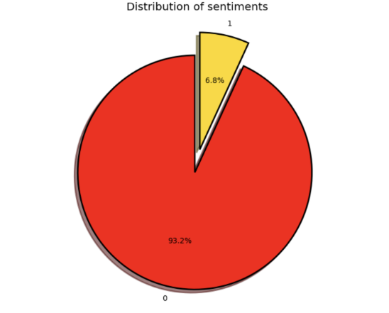
Exploratory Data Analysis.
Observed the distribution of sentiments by plotting a pie-chart
‘Red’ showing label 0 i.e. non-hate speech occupies 93.2%
Hate speech occupies only 6.8% in the dataset

Slide 6
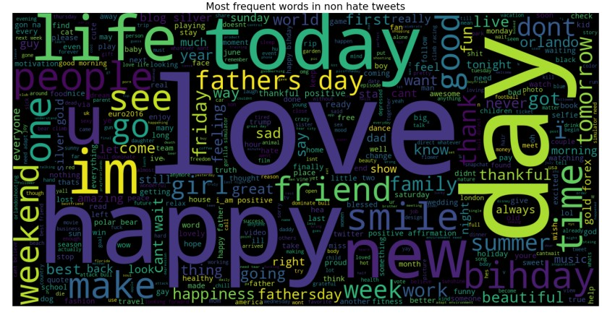
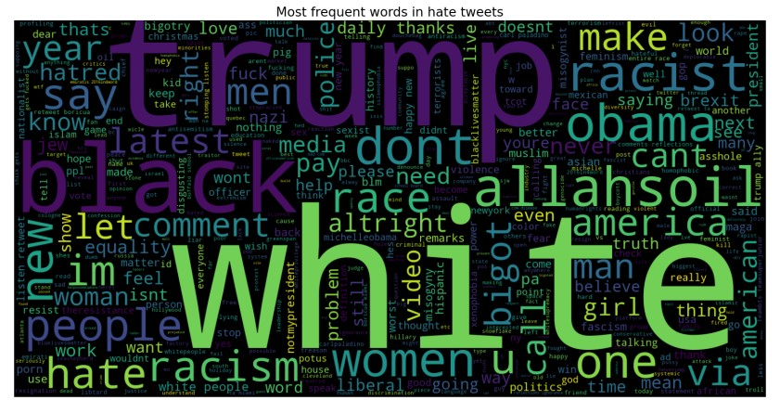
Visualizes the text data according to the frequency of each word in it.
Visualized Word cloud of hate tweet and non-hate tweet and analyzed which words occur the most
WordCloud:-

Slide 7
We used Count vectorization(Tf-idf) that measures the frequency of a word in a text against its overall frequency in the corpus.
Gives a higher relevance scores to words that occur in fewer documents within the corpus.
In our code, we created a bi-gram and trigram language model and then used TfidfVectorizer() from sklearn.feature extraction.text library to perform the vectorization.
Vectorization(additional preprocessing):-

Slide 8
Machine Learning Algorithms
Logistic Regression
Naïve Bayes
Random forest
Support Vector Machine
XGBoost

Slide 9
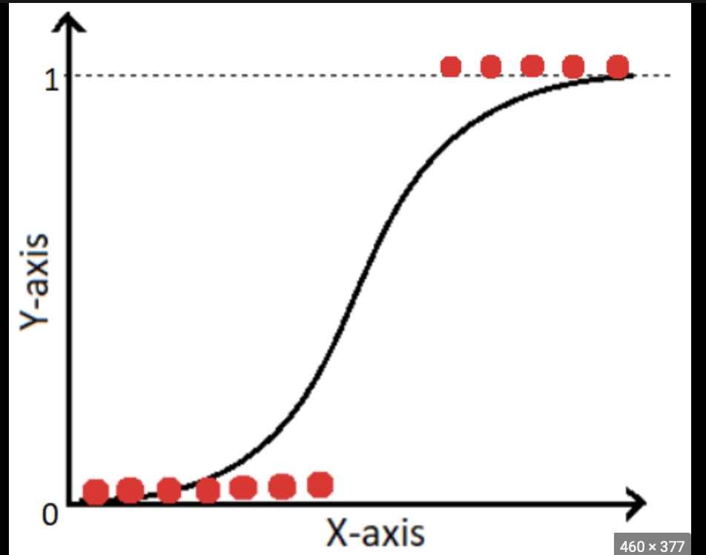
Logistic Regression
Supervised learning algorithm that estimates the probability of an event occurring
Since the outcome is a probability, the dependent variable is bounded between 0 and 1
Logit transformation(i.e. the probability of success divided by the probability of failure) is applied on the odds using Sigmoid function
Graph shows classification of labels by using Sigmoid function

Slide 10
Implementation
Optimization
Split the data into 20% testing and 80% training data.
Created an instance of the LogisticRegression() class from the sklearn.linear_model module.
Used the ‘fit’ method to fit the training samples
Use the ‘predict’ method for predicting the test sample
Performance evaluation of the model done by calculating accuracy, precision, and recall. Using sklearn.metrics module
We used hyperparameter tuning for optimization.
We optimized the below parameters for better accuracy.
Regularization strength: determines how much the model should penalize large coefficients, which can help prevent overfitting
Cross-validation to tune this parameter and find the best combination or your specific dataset

Slide 11
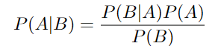
Naive Bayes
Naive- bayes models works on the principle of Bayes’ theorem with an assumption of independence among the predictors.
Naive- Bayes creates a likelihood table of the probabilities and then use Naive-Bayesian equation to calculate posterior probability of each class.
The class with highest posterior probability is the outcome of prediction. Naive Bayes theorem can be given by:

Slide 12
Implementation
Optimization
Split the data into 20% testing and 80% training data. We used GaussianNB() for classification.
Gaussian Naive Bayes classifier works by estimating the mean and variance of each feature for each class. Given a new data point, the classifier calculates the probability of each feature belonging to each class using the estimated mean and variance.
We used hyperparameter tuning for optimization.
We optimized the below parameters for better accuracy.
The smoothing parameter: smooth the probabilities estimated from the training data
The prior probabilities of the class labels: probabilities of each class label in the training data.

Slide 13
Random Forest
Random forests or random decision forests is an ensemble learning method for classification.
For classification tasks, the output of the random forest is the class selected by most trees.
Random decision forests correct for decision trees’ habit of overfitting to their training set.
Random forests generally outperform decision trees, but their accuracy is lower than gradient boosted trees. However, data characteristics can affect their performance.
In random forest n number of random samples are taken from the dataset having k number of records and then individual decision trees are constructed for each sample.
Each decision tree gives an output and then the final output is considered by majority voting for classification.

Slide 14
Implementation
Optimization
Split the data into 20% testing and 80% training data. We used RandomForestClassifier()for classification.
We fit the training data and predict using predict() function for new instances.
We used hyperparameter tuning for optimization.
We optimized the below parameters for better accuracy.
Number of trees: The number of trees in the random forest determines the complexity of model and affects the ability to generalize to new data
Maximum depth of trees: The maximum depth of each tree in the random forest determines how deep the tree can grow before it is split.
Minimum samples per leaf: The minimum number of samples that are required to be at a leaf node determines the number of splits that are made in the tree.

Slide 15
Support Vector Machine
The goal of an SVM is to find the hyperplane in a high-dimensional space that maximally separates the different classes.
The position, orientation, and width of the hyperplane are chosen so that it has the largest minimum distance to the nearest training data points of any class (so-called support vectors).
To classify a new data point, the SVM assigns it a class based on which side of the hyperplane it falls on.
One advantage of SVM classifiers is that they can handle high-dimensional data and still achieve good performance.
However, SVM classifiers can be sensitive to the choice of hyperparameters and the scaling of the input features, so it is important to tune these hyperparameters and pre-process the data appropriately.

Slide 16
Implementation
Optimization
Split the data into 20% testing and 80% training data. We used LinearSVC() for classification.
We fit the training data and predict new instances.
For optimization, we used hyperparameter tuning
We optimized the below parameters for better accuracy.
Penalty parameter C: This controls the trade-off between the smooth decision boundary and the number of support vectors.
Loss function: This determines the penalty for misclassifying a data point.
Multi-class strategy: This determines how the model handles multiple classes.

Slide 17
XGBoost
XGBoost, which stands for Extreme Gradient Boosting, is a scalable, distributed gradient boosted decision tree (GBDT) machine learning library.
It provides parallel tree boosting and is the leading machine learning library for regression, classification, and ranking problems.
Like other gradient boosting methods, XGBoost works by building a model in the form of an ensemble of weak learners, where each weak learner is a decision tree.

Slide 18
Implementation
Optimization
Split the data into 20% testing and 80% training data. We used the XGBclassifier class from xgboost module for classification.
We fit the training data and predict new instances.
For optimization, we used hyperparameter tuning
We optimized the below parameters for better accuracy.
max_depth: The maximum depth of the tree.
eta: The learning rate.
subsample: Controls the fraction of observations to be used for each tree.
colsample by tree: Controls the fraction of features to be used for each tree.

Slide 19
Hyperparameter Tuning
Hyperparameter tuning is the process of finding the optimal values for the hyperparameters of a machine learning model.
The goal of hyperparameter tuning is to find the values for the hyperparameters that result in the best performance of the model on a given task.
This can be done through a process called model selection

Slide 20
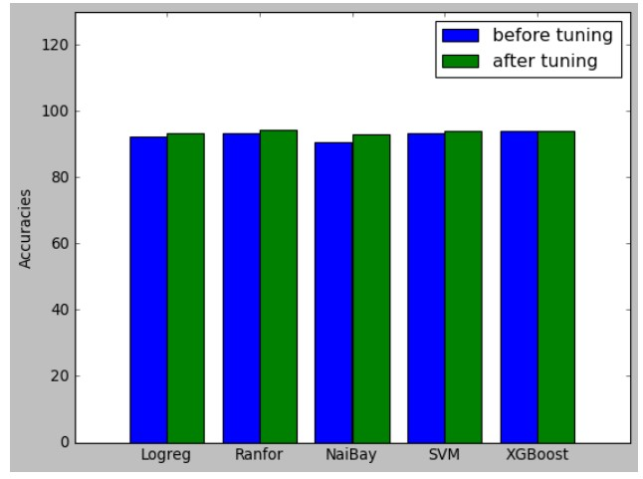
Accuracy
 | Before Tuning | After Tuning
Logistic Regression | 92.16% | 93.33%
Random Forest | 93.33% | 94.4%
Naive Bayes | 90.63% | 92.93%
Support Vector Machine | 93.23% | 93.93%
XGBoost | 93.87% | 94.12%

Slide 21
Future Directions
Future plans call for the implementation of ML techniques such RNN, LSTM, BERT, Deep Neural Networks, etc.
Additionally, we want to work with a bigger dataset that includes multiple languages.
In order to address the current problems with hate speech, we want to implement this project on any social media site. By counting the number of hateful terms in a tweet, we can rate it and automatically prevent hateful tweets from being published.

Slide 22
Conclusion
The extensive experiments and analysis show that XGBoost and Random forest are good algorithm for hate speech detection.
Implementing hyperparameter tuning helped in improving the accuracies of all the models even though the computation time for implementing hyperparameter tuning is more.

Slide 23


